Slide 1
School of Computer Science and Engineering B.Tech (CSE) 2nd Semester
Course Name : OOPs with C++
Course Code: Topic: Introduction (Unit-1)
Dr. Sahil Kansal

Slide 2
Programming Languages
Programming languages allow programmers to code software
The three major families of languages are
Machine language
Assembly language
High-Level languages

Slide 3
Machine Language
Machine language is the language which a CPU understands
It consists only of numbers: 0 & 1.
Example of code:1110100010101 111010101110
10111010110100 10100011110111
Any computer can directly understand only its own machine
language, defined by its hardware design.
Machine dependent
Difficult to program –one misplaced 1 or 0 will cause the
program to fail.

Slide 4
Assembly Language
Assembly languages are a step towards easier programming
Similar to machine language, but use naturally understandable symbols called “Mnemonics” for numeric instructions present in the machine language.
Example:
Load 5, Load 1, Add
ADD 1001010, 1011010
It works directly with microprocessor
Assembly language code needs to be translated to machinelanguage before the computer processes it.
Assembly language is intermediate between high level language and machine code.

Slide 5
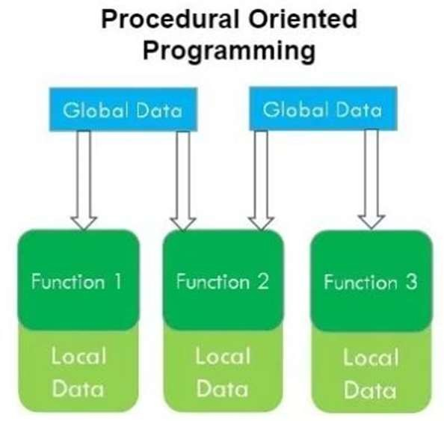
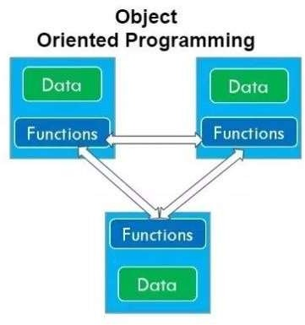
POP vs. OOP

Slide 6
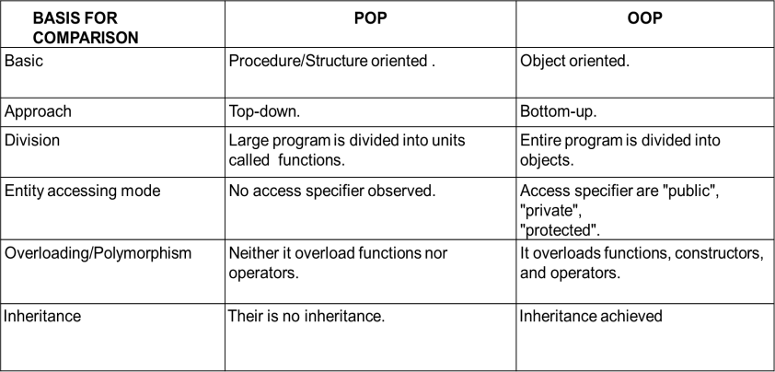
Difference : POP vs. OOP

Slide 7
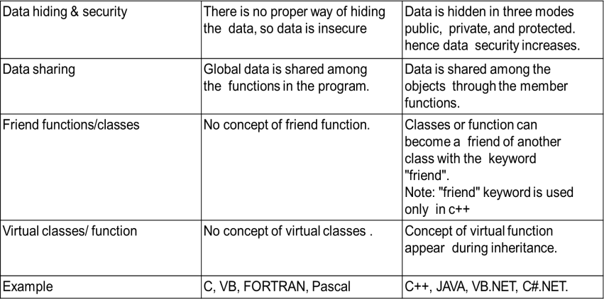
Difference : POP vs. OOP cont..

Slide 8
Object Oriented Concept
Class
Object
Abstraction
Encapsulation
Inheritance
Polymorphism
Dynamic binding
Message Passing

Slide 9
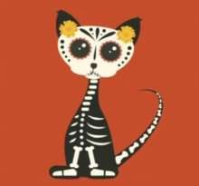


Class
It is a user-defined data type, which holds its own data members and member functions, which can be accessed and used by creating an instance of that class
Class is Blueprint for any entity which defines properties and Function.
For Example:
Class: CAT, CAR, HUMAN

Slide 10
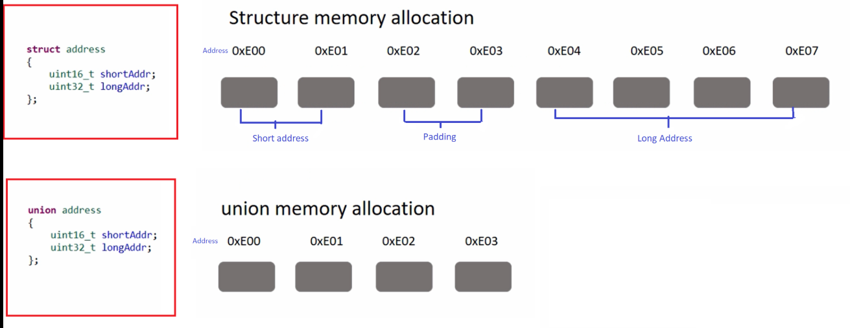
Structure and Union

Slide 11
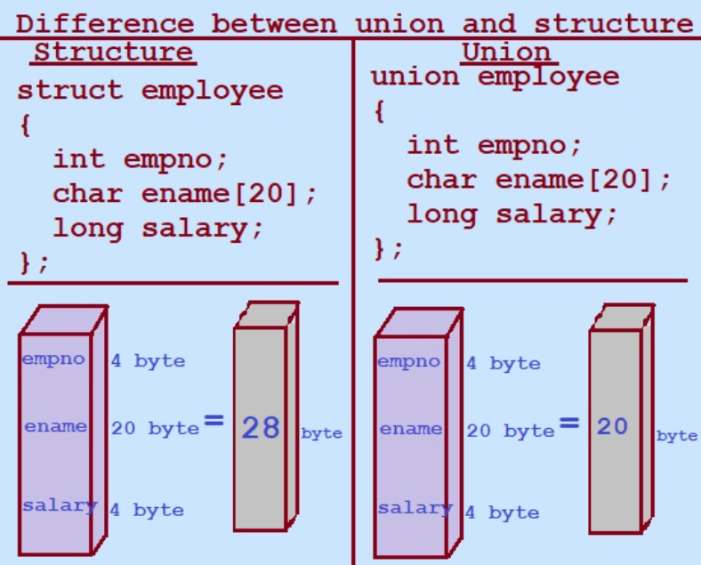
Structure and Union
Structure (struct)
A structure allocates separate memory for each member.
Characteristics
Each member has its own memory
All members can be used simultaneously
Size of structure = sum of sizes of all members (plus padding)
Members are public by default
Supports member functions and constructors (in C++)
Union (union)
A union allocates shared memory for all members.
Characteristics
All members share the same memory location
Only one member can store a value at a time
Size of union = size of the largest member
Members are public by default
Memory-efficient but less safe

Slide 12
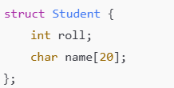
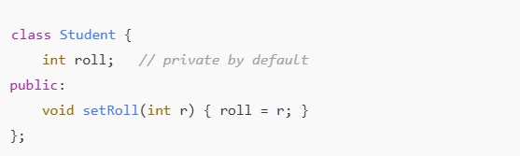
Structure and Class
Structure (struct)
Designed mainly for grouping related data
Members can be accessed directly from outside
Offers limited data protection
More suitable for small or simple programs
Class (class)
Designed to represent real-world objects
Data is hidden using access specifiers
Supports encapsulation, inheritance, and polymorphism
Used in large and secure applications

Slide 13

Object
Logical or Physical entity.
OR
Object is real world entity.
OR
Object is instance of Class.

Slide 14
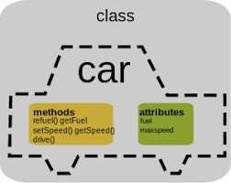
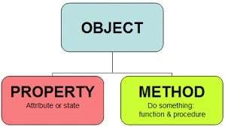
Attributes and Behaviour
Object have properties(attributes) and behaviour(Method).
For Example:

Slide 15
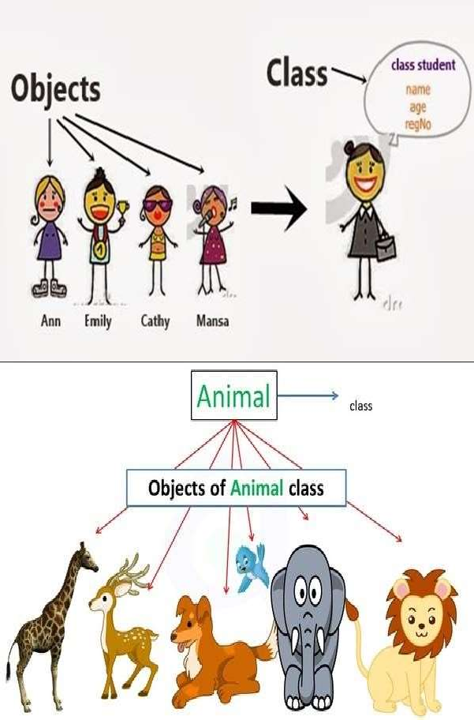
Examples

Slide 16

Abstraction
Abstraction means displaying only essential information and hiding the details. Data abstraction refers to providing only essential information about the data to the outside world, hiding the background details or implementation.

Slide 17
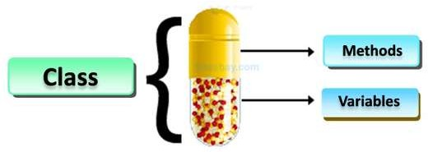
Encapsulation
Encapsulation is a process of combining data members and functions in a single unit called class.
As in encapsulation, the data in a class is hidden from other
classes, so it is also known as data-hiding.

Slide 18
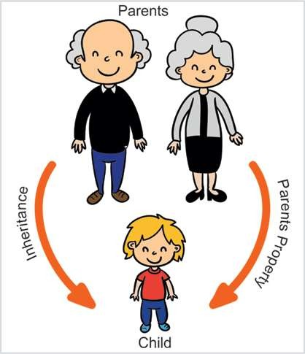
Inheritance
The capability of a class to derive properties and characteristics from another class is called Inheritance. Inheritance is one of the most important feature of Object Oriented Programming.
Child Class: The class that inherits properties from another class is called Sub class or Derived Class.
Parent Class: The class whose properties are inherited by sub class is called Base Class or Super class.

Slide 19
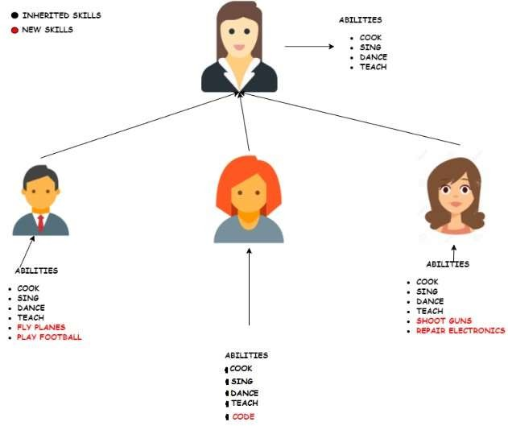
Example

Slide 20
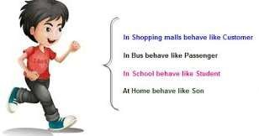
Polymorphism
we can define polymorphism as the ability of a message to be displayed in more than one form.
Real life example of polymorphism, a person at a same time can have different characteristic. Like a man at a same time is a father, a husband, a employee. So a same person posses have different behavior in different situations. This is called polymorphism.

Slide 21
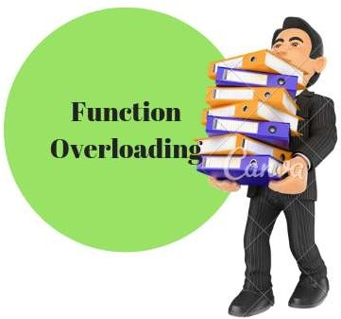
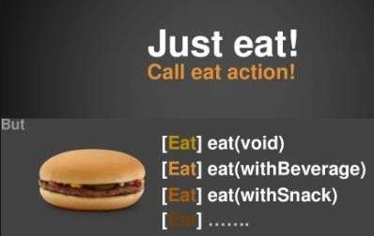
Example

Slide 22
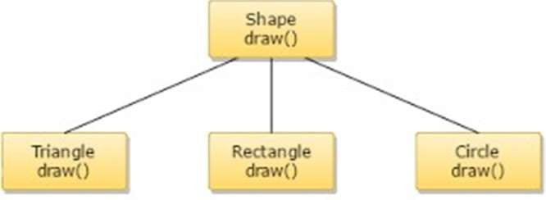
Dynamic Binding
Dynamic binding (also known as late binding ) means that the code associated with a given procedure call is not known until the time of the call at run time.
It is associated with polymorphism and inheritance. A function call associated with a polymorphic reference depends on the dynamic type of that reference.
Every Object will have draw( ) procedure, however this draw( ) will be redefined in each class.
At Run-time, the code matching the object under current reference will be called.

Slide 23
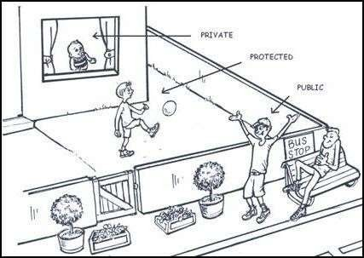
Access Modifiers
Access modifiers are used to implement important feature of Object Oriented Programming known as Data Hiding.
Access modifiers or Access Specifiers in a class are used to set the accessibility of the class members.
It sets some restrictions on the class members not to get directly accessed by the outside functions.

Slide 24
Access Modifiers
There are 3 types of access modifiers available in C++:
Public:
A public member is accessible from anywhere outside the class but within a program.
Private:
A private member variable or function cannot be accessed, or even viewed from outside the class. Only the class and friend functions can access private members.
Protected:
A protected member variable or function is very similar to a private member but it provided one additional benefit that they can be accessed in child classes which are called derived classes.

Slide 25
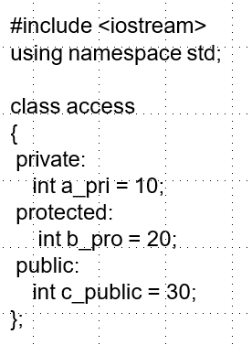
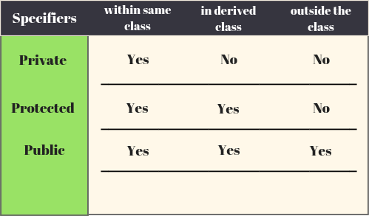
Access Modifiers

Slide 26
CC++ Program Structure
Include files
Class Declaration
Member Function Definition
Main function

Slide 27
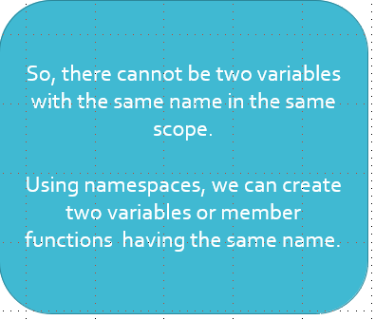
Namespace Example
int main()
{
int value;
value = 0;
double value; //Error
value=0.0;
}

Slide 28
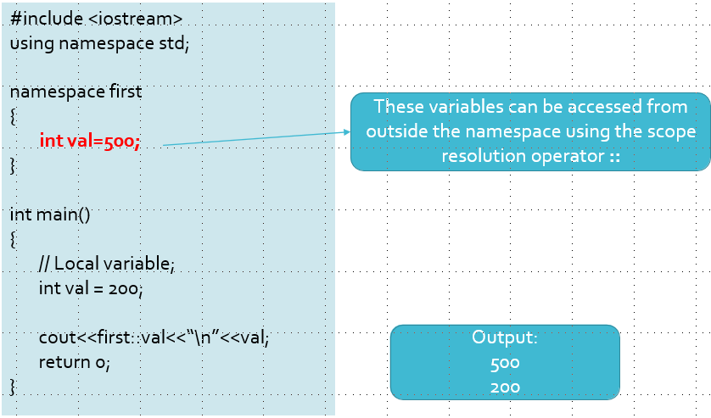
Namespace Example

Slide 29
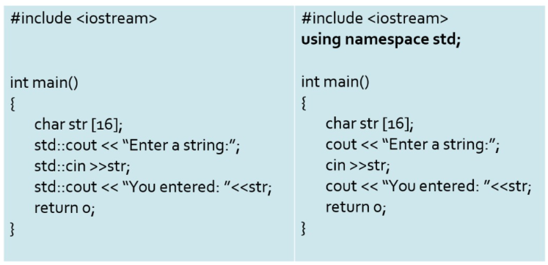
Namespace Example

Slide 30
High level Language
High-level languages represent a giant leap towards easier programming.
The syntax of HL languages is similar to English.
Historically, we divide HL languages into two groups:
1 Procedural languages
Ex. C language
2 Object-Oriented languages (OOP)
Ex. C++, Java, C#

Slide 31
Thanks

